Slide 1
Vibration Energy Harvesting Based on Piezoelectric Materials
School of Mechanical Engineering
Maoying Zhou
2019-11-04

Slide 2
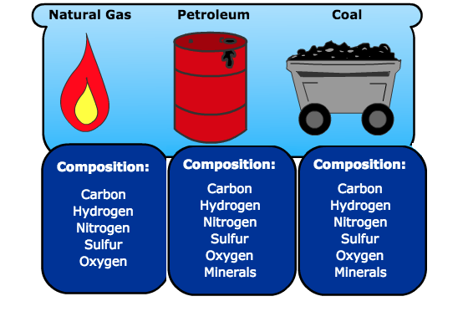
1. Why Energy Harvesting
Gas
Oil
Coal
Depletion of Fossil Fuels:
Global fossil fuel statistics based on proved reserves
Fuels | Total Reserves | Production/day | End (date) *
Oil | 1.689 Tb | 86.81 Mb | 2066
Gas | 6558 TCF | 326 BCF | 2088
Coal | 891.531 BT | 21.63 MT | 2126
* End dates may shift ahead after new discoveries.
Adapted from Abas et al. 2015

Slide 3
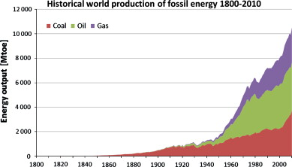

1. Why Energy Harvesting
Environmental Problems:
Pollutions
Carbon Emission
Historical world production of fossil energy 1800-2010 (Adapted from Hook and Tang 2013)

Slide 4

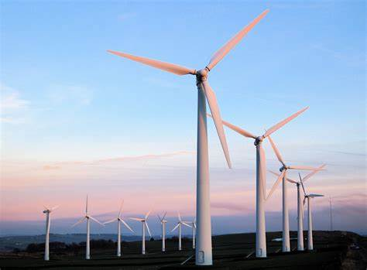

1. Why Energy Harvesting
Solar Energy
Wind Energy
Ocean Energy
Nuclear Energy……
Renewable and Sustainable Energies
Alternative
Energy Harvesting from the Ambient Environment

Slide 5
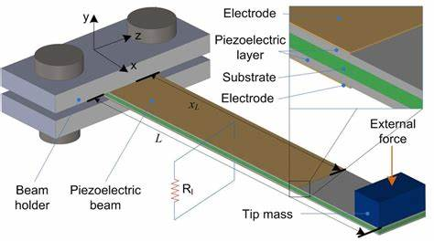
2. What Is Energy Harvesting
Energy Harvesting: Using smart materials and smart structures to convert ambient energy into electricity.
Vibration Energy
Solar Energy
Wind Energy
Wave Energy
…
Piezoelectric materials
Electrostatic materials
Electromagnetic materials
Triboelectric materials
…

Slide 6
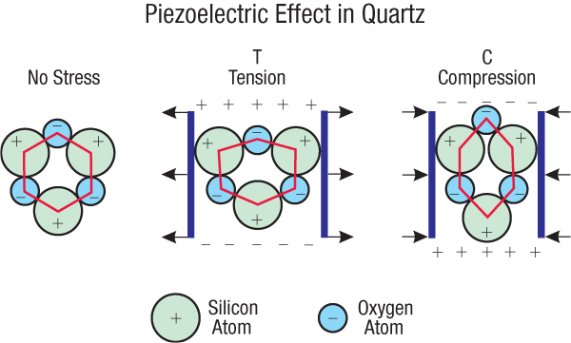
3. Piezoelectric Energy Harvesting
What is Piezoelectricity?
Unloaded, the crystal in a electric neutral position. The geometric center of positive charge is coincident with that of the negative charges.
Loaded, mechanical strain generated. Electrical dipoles generated
Strain in one direction leads to electrical dipoles in other directions, d31, d33

Slide 7
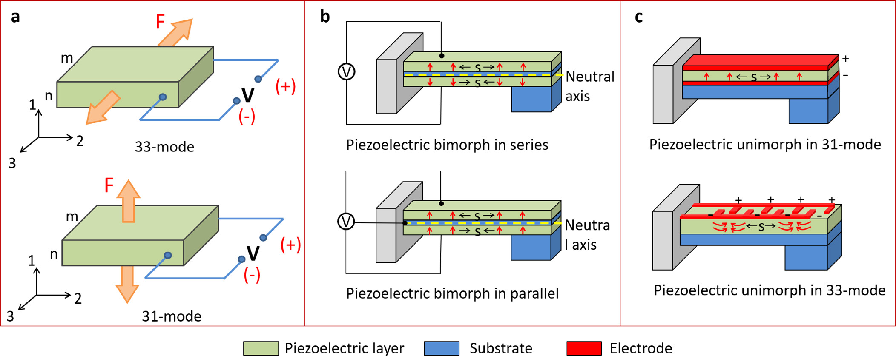
3. Piezoelectric Energy Harvesting
How is Piezoelectric Energy Harvesting Realized?

Slide 8
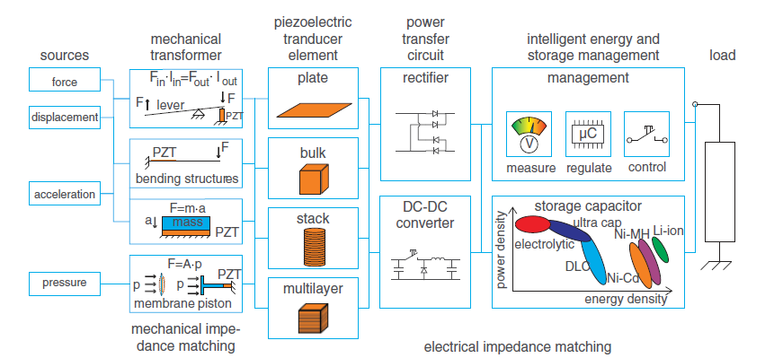
3. Piezoelectric Energy Harvesting
What are the Typical Components of Piezoelectric Energy Harvesting Devices?

Slide 9



3. Piezoelectric Energy Harvesting
Vibration Source
Vibration Subject to Instability or Imperfection
Vibration Due to Fluid Structure Interaction
Vibration Due to Base Excitation
All Kinds of Random Vibrations

Slide 10

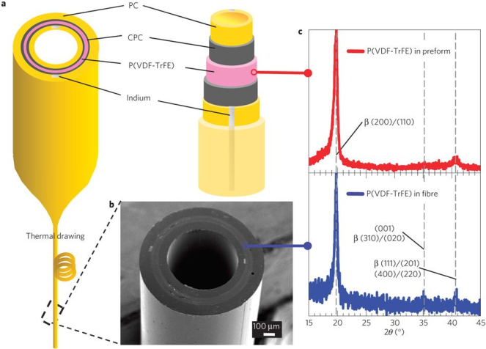
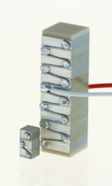
3. Piezoelectric Energy Harvesting
Piezoelectric Materials
PZT
PVDF
ZnO
BaTiO₃
….
Piezoelectric Elements
Films and Plates
Fiberss
Stacks

Slide 11
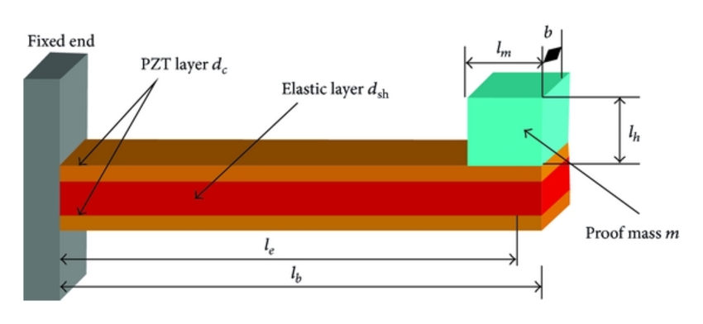
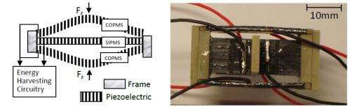
3. Piezoelectric Energy Harvesting
Transduction Mechanisms

Slide 12
3. Piezoelectric Energy Harvesting
Matching Circuits
Convert High Voltage Low Current Signal to Low Voltage High Current Output
Smartly Tune the Circuit to Different Input Signal Frequency
Keep High Output Performance for Different Loads
Bridge the Gap between Output Power and Load Power Requirement
Battery Charging and Management

Slide 13
4. Examples
Adapted from Fu et al. 2018

Slide 14
4. Examples
A Typical Piezoelectric Energy Harvesting Device Is Based on a Piezoelectric Composite Cantilever Beam

Slide 15
4. Examples
The Piezoelectric Energy Harvesting Device Is Usually Attached to a Base Excitation Source, Which Input Energy Into the System

Slide 16
4. Examples
The Piezoelectric Plates Are Wired to Externally Connected Circuit, Usually a Resistor in the Simplest Case

Slide 17
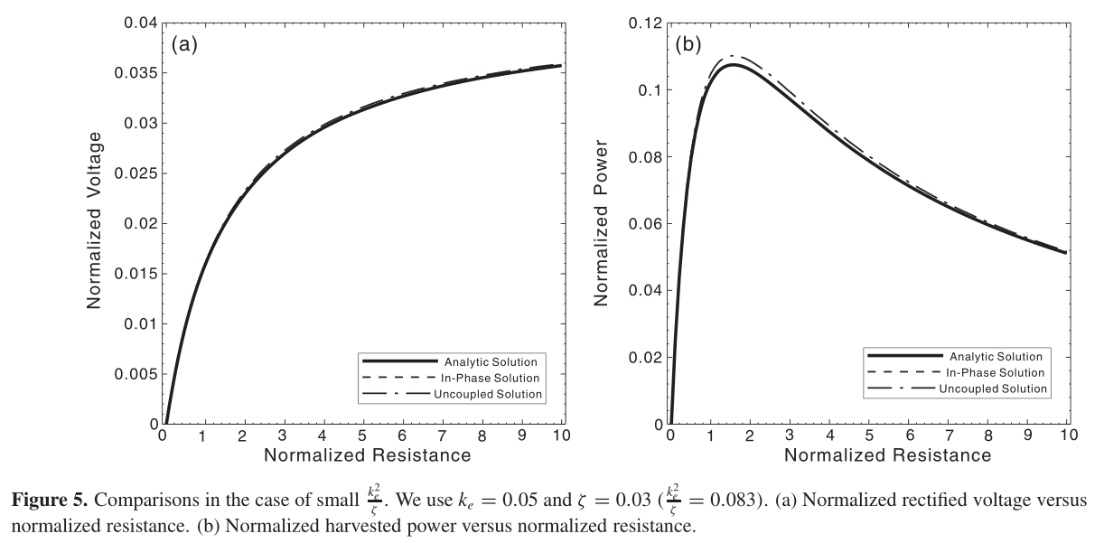
4. Examples
Adapted from Shu and Chen 2006

Slide 18
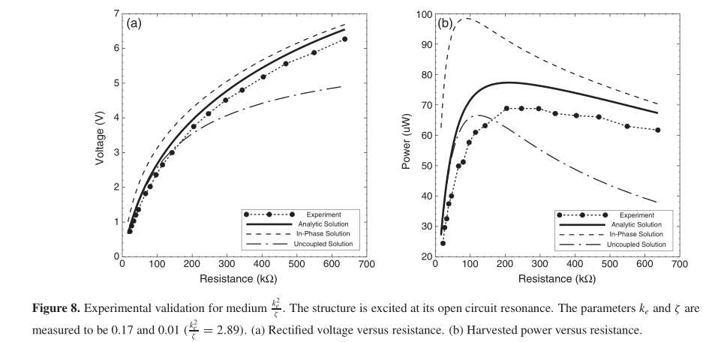
4. Examples
Adapted from Shu and Chen 2006

Slide 19
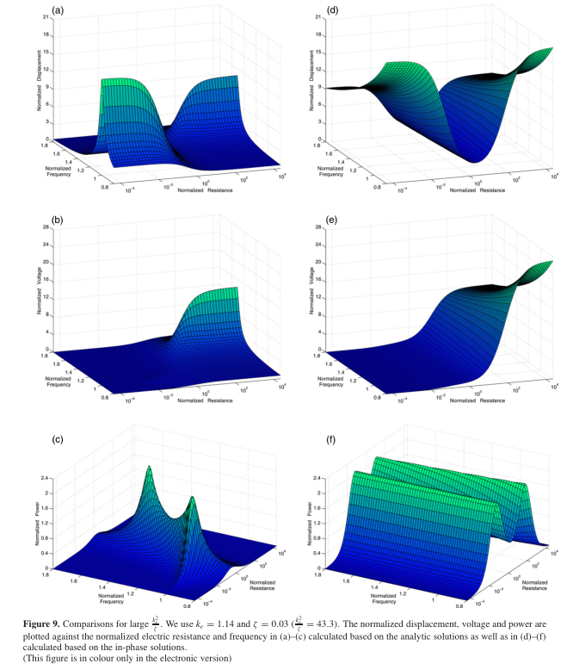
4. Examples
Adapted from Shu and Chen 2006

Slide 20

谢 谢！
Thank you！

